Slide 1
From weights to outputs:
embedding watermarks into deep neural networks
04/02/2022
Jianwei Fei

Slide 2
Contents
I Preliminary on (DNN) watermarking
Taxonomy
Brief review
Requirements
Attacks
II Latest progress on GAN watermarking
Typical methods
Function and effect
III Open problems
Limitations of current methods
Possible solutions
Unresearched scene (threat model)

Slide 3
Contents
I Preliminary on (DNN) watermarking
Taxonomy
Difference between traditional & DNN watermarking
Brief review
II Latest progress on GAN watermarking
Typical methods
Function and effect
III Open problems
Limitations of current methods
Unresearched scene (threat model)
Possible solutions

Slide 4
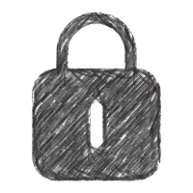
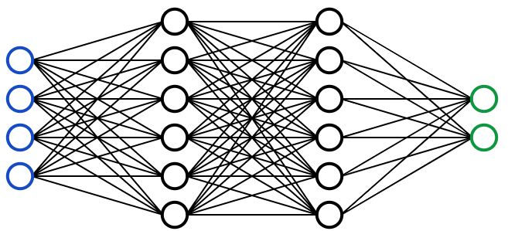
1、
I|White-box
Taxonomy
White box watermarking
Model owner
Attacker
Verifier
K
Unintentional or malicious attacks
Extraction Algorithm
Embedding Algorithm
K
1
0
1
0
Marked
0
1
0
1
1
0
√
1
0
0
1
0
1
Distribute
验证
Mainstream
Attacks
Adjust weights during training and use weights as watermarks
finetuning
Embed watermarks in the intermediate features of trigger samples
pruning
Add new layer as watermarks
rewriting

Slide 5
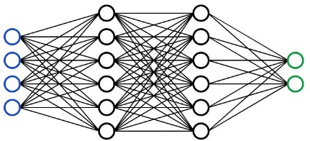
1、
I|Overall pipeline
Taxonomy
distribution
Weights as watermarks
Maps as watermarks
New layer as watermarks
input
input
Conv Layer 1
Conv Layer 1
New Layer
Conv Layer $i$
Conv Layer $i$
$$Y=σ$$
$$X$$
$$W$$
New Layer
$$Y=σ$$
$$X$$
$$W$$
Conv Layer N
Conv Layer N
1
0
1
0
Loss
0
1
0
1
New Layer
1
0
1
0
Loss
0
1
0
1
FC
FC
finetuning
finetuning
outputs
outputs

Slide 6
1、
I|Black-box
Taxonomy
Embedding Stage
triggers
label：cat
train
Extracting Stage
triggers
ouptus
Trigger predefine labels
（ cat ）
Training Mode
triggers：Samples leads to specific outputs（different from normal data）
Outputs of triggers are independent of its content
Relations between triggers and labels are known by owners only
Finetuning
Train from sractch

Slide 7
1、
I|Requirements
Robustness
Against multiple attacks
Unobtrusiveness(Fidelity)
Secrecy
Should be undetectable
security
Unforgeability
Should be unforgeable
Fidelity
Not affecting performance on original task
Capacity
Robustness
Capacity
Embedding more bits
practicability
Reliability / Integrity
Exhibiting Minimal False
Generality
Should be independent of dataset / models
Eggers, Joachim, and Bernd Girod.
Informed watermarking.
Vol. 685. Springer Science & Business Media, 2002.
Efficiency
Should not be too slow

Slide 8
1、
I|Requirements
Other requirements：
Threshold for watermarking verification：
Its trade-of between and Reliability (false negative). and Integrity (false alarm).
Undetectable
Embedding watermarks into DNNs leaves detectable traces, violating Secrecy.
Nontransitability
Adversarial examples have transferability, methods that adjust decision boundaries by triggers may violate Integrity.

Slide 9
1、
I|Attacks
Watermark Detection
Detecting the existing of watermarks in the model, (the adversary can take measures in advance to avoid watermark verification)
Watermark Suppression
Suppress the behavior of triggers to avoid watermark verification
Watermark Removal
Retrain, finetuning, pruning, quantification
Watermark Overwriting
Adversary knows watermarking scheme and embeds new watermarks.
weak：2 watermarks coexist, so that the real owner can no longer prove his ownership
strong：Adversary replaces the watermark with a new one, taking over ownership
Watermark Forging
Adversary uses additional triggers to forge the ownership

Slide 10
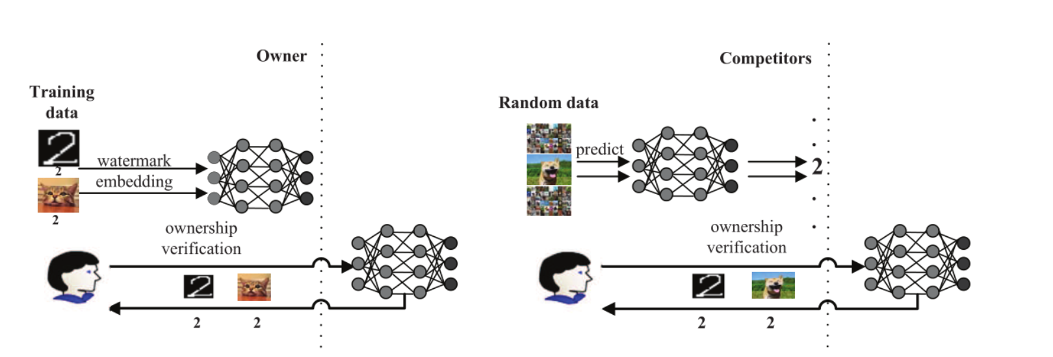
1、
I|Attacks
Watermark Forging
Adversary uses additional triggers to forge the ownership
Embedding Stage (Legal)
Forging Stage (Illegal)

Slide 11
1、
I|Attacks
Fine-Tuning
Pruning
Rounding
Fine-Pruning
Model Compression
Distillation
Transfer Learning
Computation Optimization
Backdoor Removal
Retraining
Watermark
Removal

Slide 12
1、
I|Attacks
Fine-Tuning
Pruning
Rounding
Fine-Pruning
Model Compression
Distillation
Transfer Learning
Computation Optimization
Backdoor Removal
Retraining
Watermark
Removal

Slide 13
1、
I|Prototype of DNN watermarking
Song’s Method （Earliest model marking method, but used for attacks）
earlier than Uchida’s method
White-box settings:
Encoding S in the least significant bits of weights
① train the model (on original task)
② replace LSB with S
(2) Forcing weights to be highly correlated with S
Pearson correlation of weights and S as additional loss
(3) Encoding S in the sign of weights
① generating ${\text{S}∈\{−1,1\}}^{l}$
② add additional loss P
Song C, Ristenpart T, Shmatikov V. Machine learning models that remember too much[C]
//Proceedings of the 2017 ACM SIGSAC Conference on computer and communications security. 2017: 587-601.

Slide 14
1、
I|Prototype of DNN watermarking
Important conclusions
Models can endure the modification of more bits on binary classification (easier task, more redundancy)
Larger models have stronger ability to memorize arbitrary data
Non-regularization-like operations significantly change weights distribution
Song C, Ristenpart T, Shmatikov V. Machine learning models that remember too much[C]
//Proceedings of the 2017 ACM SIGSAC Conference on computer and communications security. 2017: 587-601.

Slide 15
GAN Watermarking

Slide 16
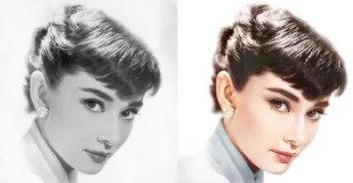
2、
II|GAN Watermarking
G
D
Image
Target model
Generated
Image

Slide 17
2、
II|GAN Watermarking
Target model Training
Watermark Extraction
G
D
1
0
1
0
0
1
0
1
Image
Target model
Generated
Image
Watermark
Extraction Net
Recovered Watermark

Slide 18
2、
II|GAN Watermarking
Target model Training
Watermark Extraction
G
D
1
0
1
0
0
1
0
1
Image
Target model
Generated
Image
Watermark
Extraction Net
Recovered Watermark
Source Tracking
GAN IP protection
Fake Content Detection

Slide 19
2、
II |ICCV 2021
①Watermark Embedding Net Training
1
0
1
0
0
1
0
1
Origin Image
Watermark Embedding Net
Watermarked Image
Recovered Watermark
Watermark Extraction Net
② Watermark Embedding
③Target model Training
④ Watermark Extraction
G
D
1
0
1
0
0
1
0
1
Origin Dataset
Watermark Embedding
Net
Watermarked Dataset
Target model
Generated
Image
Watermark
Extraction Net
Recovered Watermark
[1]Yu N, Skripniuk V, Abdelnabi S, et al. Artificial fingerprinting for generative models: Rooting deepfake attribution in training data ICCV 2021

Slide 20
2、
II |ICCV 2021
ICLR Comments
R1 (6, Marginally above acceptance threshold):
I am curious that at what stage were the fingerprints learned when training GAN? Does the GAN model first learn how to generate images, and then learn how to generate fingerprints? Or the GAN learn to generate fingerprints and images at the same time?
What if we train a network to remove fingerprints? Will it cause the methods in this paper to be attacked or misused?
[1]Yu N, Skripniuk V, Abdelnabi S, et al. Artificial fingerprinting for generative models: Rooting deepfake attribution in training data ICCV 2021

Slide 21
2、
II |ICCV 2021
What if we train a network to remove fingerprints? Will it cause the methods in this paper to be attacked or misused?
[1] Cozzolino D, Thies J, Rossler A, et al. SpoC: Spoofing camera fingerprints CVPRW 2021

Slide 22
2、
II |ICCV 2021
ICLR Comments
R3 (4, Ok but not good enough - rejection):
Studying and exploring how and how well the fingerprints can be learned by GANs is a more valuable contribution. If there exist some fingerprints that cannot be learned or be transfer to GAN generated images. And what the GAN will perform if we use mixed training data with different fingerprints to train it.
If different sources (person/company/apps) employ different fingerprints (i.e., fingerprint encoder), can the decoder successfully perform the detection/attribution?
[1]Yu N, Skripniuk V, Abdelnabi S, et al. Artificial fingerprinting for generative models: Rooting deepfake attribution in training data ICCV 2021

Slide 23
2、
I|ICCV 2021
4×image level perturbations
2×model level perturbations
No Fine-Tuning or Pruning results
Attacks
ProGAN （CelebA）
[1]Yu N, Skripniuk V, Abdelnabi S, et al. Artificial fingerprinting for generative models: Rooting deepfake attribution in training data ICCV 2021

Slide 24
2、
II|TCSVT 2020
Origin Img
Target model
Generated Img
Discriminator
Img Encoder
Watermark Extraction Net
Recovered Watermark
1
0
1
0
0
1
0
1
keys
Key Encoder
[1] Wu H, Liu G, Yao Y, et al. Watermarking neural networks with watermarked images TCSVT 2020

Slide 25
2、
II|TCSVT 2020
Origin Img
Target model
Generated Img
Discriminator
Case 1: key correct，image with W
Case 2: key correct ， image w/o W
Img Encoder
Watermark Extraction Net
Recovered Watermark
Case 3: key incorrect ， image w/o W
1
0
1
0
0
1
0
1
keys
Key Encoder
[1] Wu H, Liu G, Yao Y, et al. Watermarking neural networks with watermarked images TCSVT 2020

Slide 26
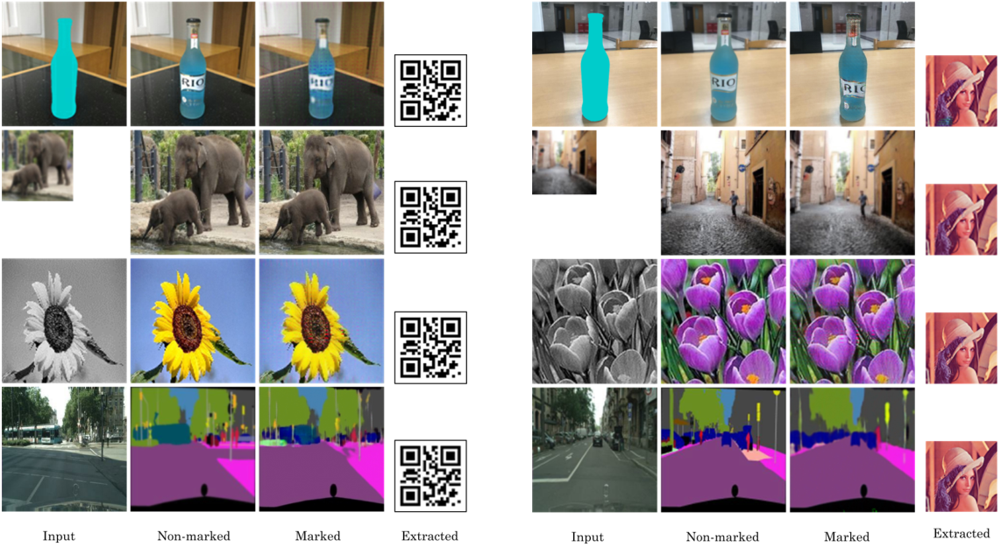
2、
II|TCSVT 2020
[1] Wu H, Liu G, Yao Y, et al. Watermarking neural networks with watermarked images TCSVT 2020

Slide 27
2、
II|TCSVT 2020
Image：256
Watermark：64
0: No-marked model Img ﹤ ﹣ ﹣ ﹣ ﹥ GT
1: Marked model Img ﹤ ﹣ ﹣ ﹣ ﹥ GT
2: Marked model Img ﹤ ﹣ ﹣ ﹣ ﹥ No-marked model
[1] Wu H, Liu G, Yao Y, et al. Watermarking neural networks with watermarked images TCSVT 2020

Slide 28
2、
II|TCSVT 2020
- The author did not give results of robustness but give solutions against noise and crop
use cropped or noised images to train the GAN
- No model level attacks discussed
[1] Wu H, Liu G, Yao Y, et al. Watermarking neural networks with watermarked images TCSVT 2020

Slide 29
2、
GAN Watermarking
D
水印图像
Discriminator
G
Watermark Embedding Net
Watermark Extraction Net
Target model
Watermarked Generated Img
Recovered Watermark
Generated Img
G
Surrogate Net
Watermark Extraction Net
Watermarked Generated Img
Recovered Watermark
Origin Img
D
.
Discriminator
[1] Zhang J, Chen D, Liao J, et al. Deep Model Intellectual Property Protection via Deep Watermarking. TPAMI 2021

Slide 30
2、
GAN Watermarking
D
Adversarial training stage
Ensure the surrogate model learns the watermarks too
水印图像
Discriminator
G
Watermark Embedding Net
Watermark Extraction Net
Target model
Watermarked Generated Img
Recovered Watermark
Generated Img
G
Surrogate Net
Watermark Extraction Net
Watermarked Generated Img
Recovered Watermark
Origin Img
D
.
Discriminator
[1] Zhang J, Chen D, Liao J, et al. Deep Model Intellectual Property Protection via Deep Watermarking. TPAMI 2021

Slide 31
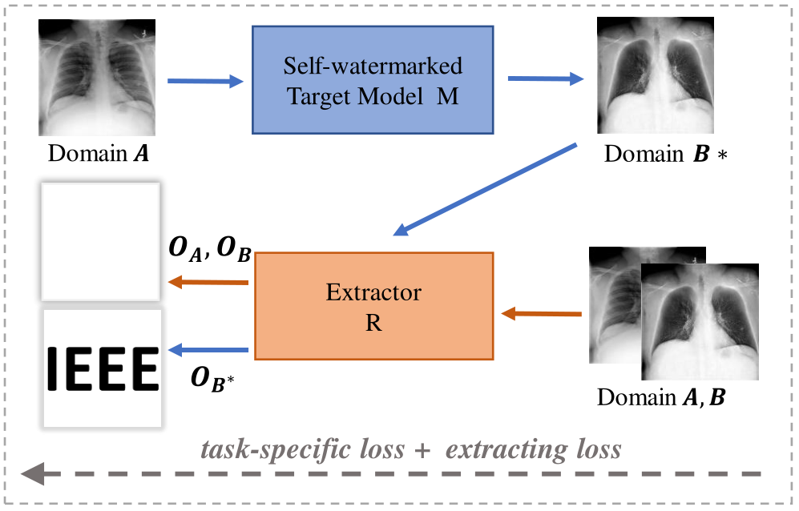
2、
GAN Watermarking
[1] Zhang J, Chen D, Liao J, et al. Deep Model Intellectual Property Protection via Deep Watermarking. TPAMI 2021

Slide 32
2、
II|CVPR 2021
[1] Ong D S, Chan C S, Ng K W, et al. Protecting Intellectual Property of Generative Adversarial Networks from Ambiguity Attacks . CVPR 2021

Slide 33
2、
II|CVPR 2021
DCGAN (noise→image)
SRGAN (image →image, different resolution)
CycleGAN (noise→image, same resolution)
[1] Ong D S, Chan C S, Ng K W, et al. Protecting Intellectual Property of Generative Adversarial Networks from Ambiguity Attacks . CVPR 2021

Slide 34
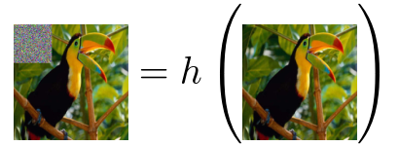
2、
II|CVPR 2021
DCGAN (noise→image)
Input transformation function：
Output transformation function：
SRGAN (image →image, different resolution)
Alternative input transformation function：
CycleGAN (noise→image, same resolution)
[1] Ong D S, Chan C S, Ng K W, et al. Protecting Intellectual Property of Generative Adversarial Networks from Ambiguity Attacks . CVPR 2021

Slide 35
2、
II|CVPR 2021
DCGAN (noise→image)
CIFAR10： 32 × 32 watermark：16 × 16
CUB200 64 × 64
SRGAN (image →image, different resolution)
350k images from ImageNet
24 × 24 → 96 × 96 watermark：12 × 12 (on input) 48 × 48 (on output)
CycleGAN (noise→image, same resolution)
Cityscapes dataset: 128 × 128 watermark：32 × 32
[1] Ong D S, Chan C S, Ng K W, et al. Protecting Intellectual Property of Generative Adversarial Networks from Ambiguity Attacks . CVPR 2021

Slide 36
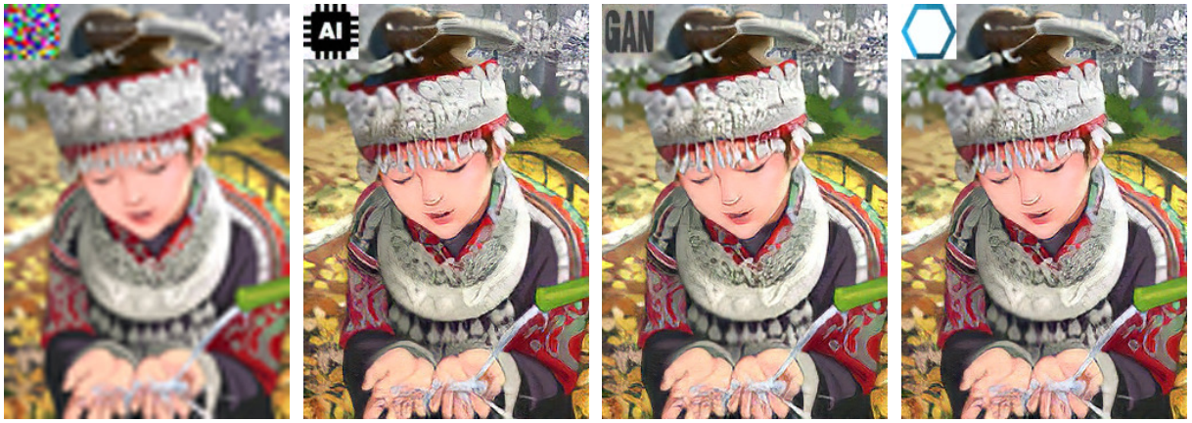
2、
II|CVPR 2021
DCGAN (noise→image)
SRGAN (image →image, different resolution)
CycleGAN (noise→image, same resolution)
[1] Ong D S, Chan C S, Ng K W, et al. Protecting Intellectual Property of Generative Adversarial Networks from Ambiguity Attacks . CVPR 2021

Slide 37
2、
II|CVPR 2021
White-box
scaling factors of normalization layers with C channels
defined binary bit signature
a constant
[1] Ong D S, Chan C S, Ng K W, et al. Protecting Intellectual Property of Generative Adversarial Networks from Ambiguity Attacks . CVPR 2021

Slide 38
2、
II|CVPR 2021
Robustness
Fine-tuning and Overwriting
SSIM of watermarks between trigger input and normal input
[1] Ong D S, Chan C S, Ng K W, et al. Protecting Intellectual Property of Generative Adversarial Networks from Ambiguity Attacks . CVPR 2021

Slide 39
2、
II|CVPR 2021
Robustness
Fine-tuning and Overwriting
[1] Ong D S, Chan C S, Ng K W, et al. Protecting Intellectual Property of Generative Adversarial Networks from Ambiguity Attacks . CVPR 2021

Slide 40
2、
II|CVPR 2021
Robustness
Sign modification
Set5，set14，BSD： test set of BSD300
Per-pixel/class acc/IoU: metric for segmentation
[1] Ong D S, Chan C S, Ng K W, et al. Protecting Intellectual Property of Generative Adversarial Networks from Ambiguity Attacks . CVPR 2021

Slide 41
2、
II|CVPR 2021
Robustness
Sign modification
0% 10%
0% 10%
[1] Ong D S, Chan C S, Ng K W, et al. Protecting Intellectual Property of Generative Adversarial Networks from Ambiguity Attacks . CVPR 2021

Slide 42
3、
III|limitations
Tasks are easy（datasets：MNIST\Cifar10，models：MLP\VGG）
Watermarks embedding and main tasks are not bound
Model-level attacks are not researched (for box-free watermarking)

Slide 43
3、
III| Possible solutions
Dynamic watermarking
Model behavior(relation between watermarks and activations, activations of specific neuros, unexplainable outputs, What kind of behavior? ）
Observation of model behavior（outputs?、 activations? Where is the behavior?）
Trigger output of model behavior（selection、construction, How to trigger the behavior? ）
Training process of model behavior（How the behavior is learned? ）
How many triggers can be used without affecting the model's ability on the original task?
Should distribution of triggers be close to data distribution, or as far away as possible?

Slide 44
3、
III|Possible solutions
Pruning robustness
Ensure the weights for watermarking embedding are relevant to the main task
Extend watermarks to more parameters （ parameters with larger absolute values）
Surrogate attack robustness
Correlate the transmission of the watermarks to the number of queries needed to train surrogate model
Known properties
Watermark is more robust when the model is trained from scratch instead of fine-tuning
Watermark is more likely to be preserved after fine-tuning if the model is trained with fewer epochs

Slide 45
3、
III|Unresearched scene
Model distribution / supervision (watermarks as license)
Data
and Computation

Slide 46
3、
III|Unresearched scene
Model distribution / supervision (watermarks as license)
Data
and Computation
Model as service /commodity
If there are restrictions in the agreement. How to trace the client who violates the agreement?
…
Client A
Client B
Client C
Client N

Slide 47
3、
III|Unresearched scene
Model distribution / supervision (watermarks as license)
Data
and Computation
Model as service /commodity
What if the model is potentially harmful and publishing such models requires license?
Government
…
Client A
Client B
Client C
Client N

